Slide 1

Heat and Thermodynamics
Dr. Md. Anisur Rahman
Assistant Professor (Physics)
University of Asia Pacific
Dhaka, Bangladesh

Slide 2
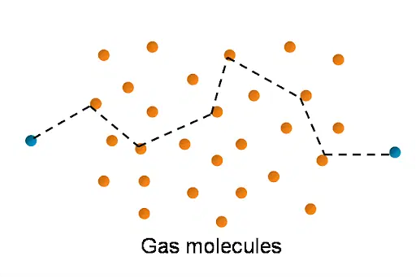
Mean Free Path of a Gas Molecule
The mean free path of a particle, is the average distance covered by a particle (photon, atom or molecule) between subsequent impacts. The direction of the molecule is changed after every collision. After a number of collisions, the total path appears to be zig-zag and the free path is not constant. Therefore a term mean free path is used to indicate the mean distance travelled by a molecule between two collisions. If the total distance travelled after N collisions is S, then the mean free path λ is given by
(1)

Slide 3
Let the molecules be assumed to be spheres of diameter d. A collision between two molecules will take place if the distance between the centres of the molecule is d.

Slide 4
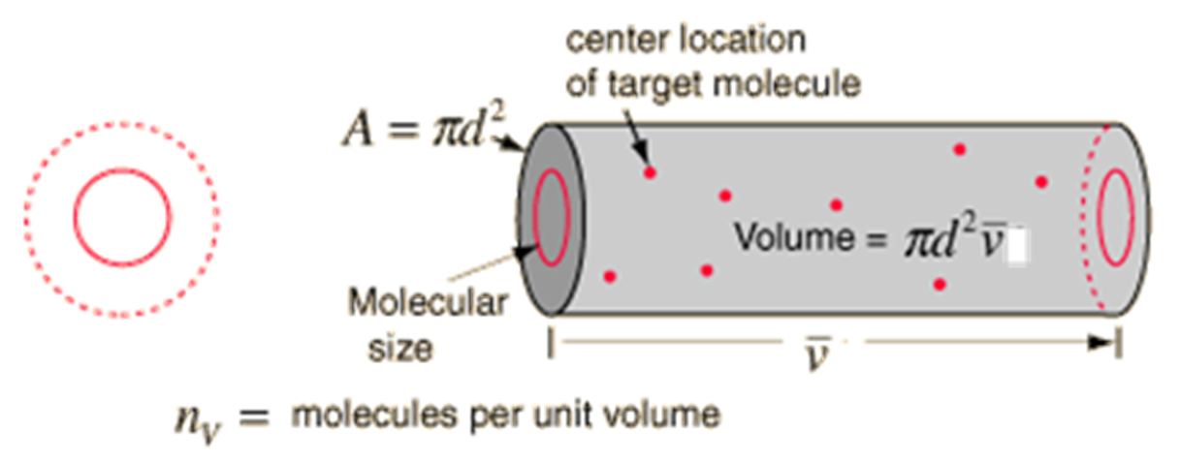
Collision will also occur if the colliding molecule has a diameter 2d and the other molecule is simply a geometrical point. Thus all other molecules to be geometrical points and the colliding molecule of diameter 2d, this molecule will cover a volume πd²v in one second. This corresponds to the volume of a cylinder of diameter 2d and length v.

Slide 5
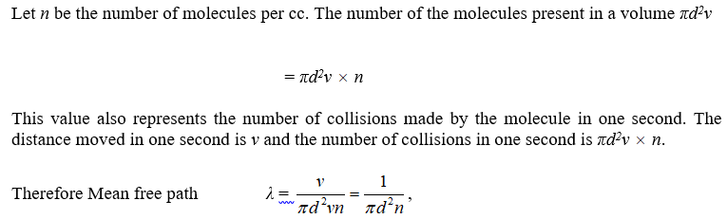
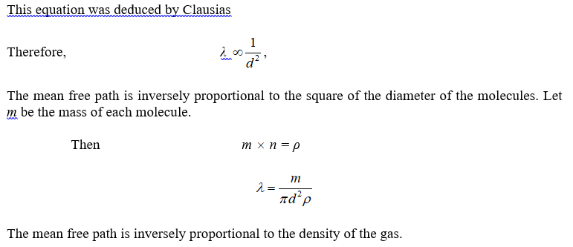

Slide 6
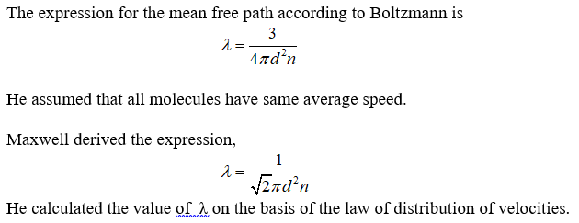

Slide 7
Van der Walls Equation of State: The redesigning of ideal gas law
The equation of state of the perfect gas, PV = RT was derived from the kinetic theory of gases on the basis of two fundamental postulates viz,
(i) The volume of the gas molecules is negligible as compared with the total volume of the gas.
(ii) The force of inter-molecular attraction is neglected on each other.
But in real gases, these assumptions are not true at high pressure and low temperature.

Slide 8
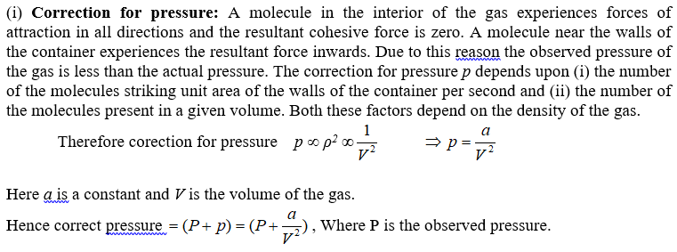
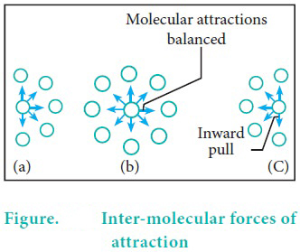

Slide 9
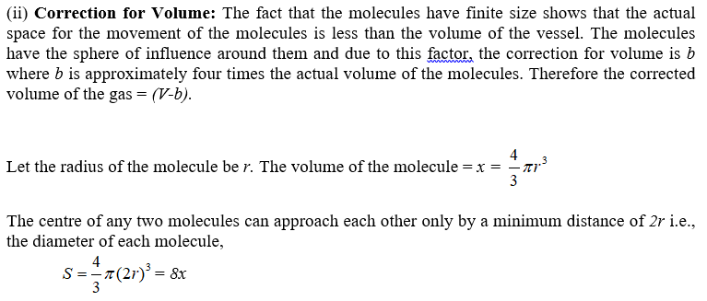
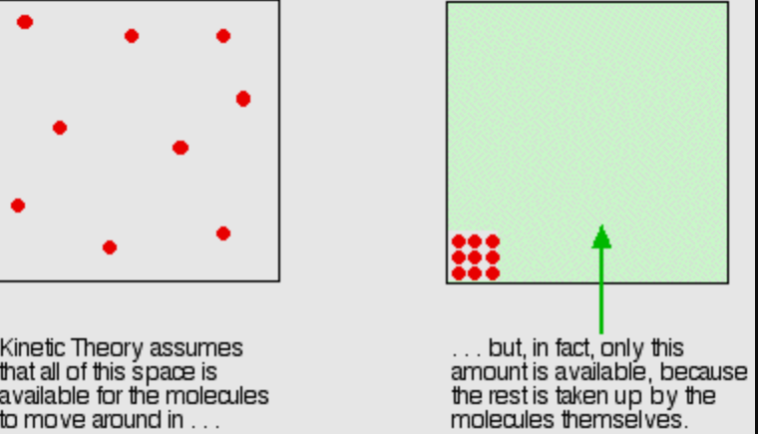

Slide 10
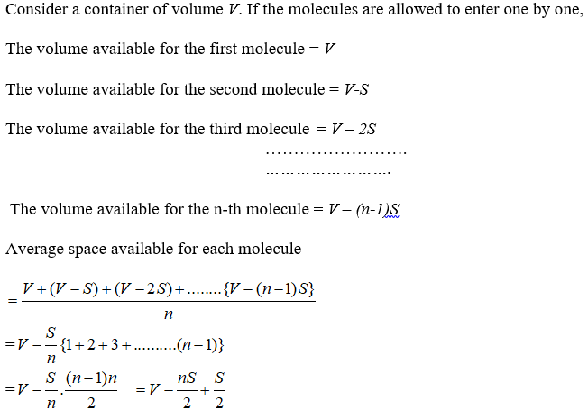

Slide 11
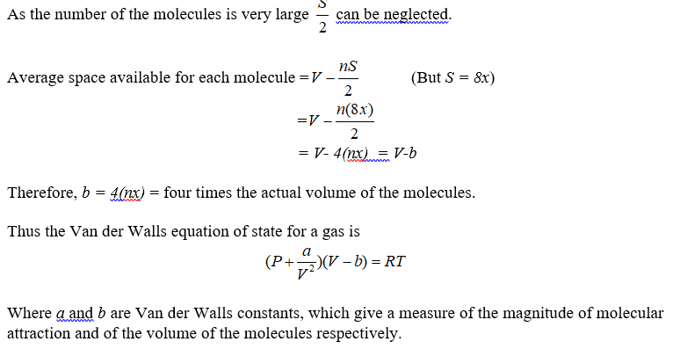
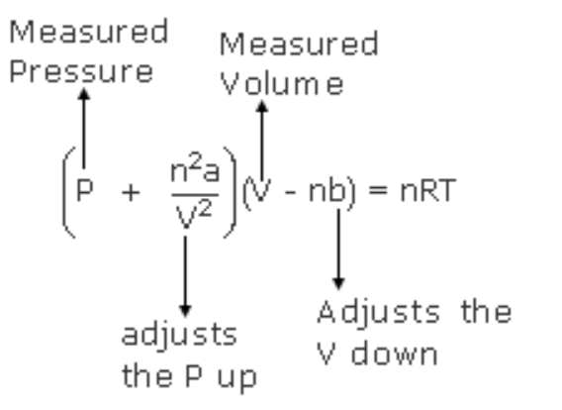
For n mol gas …………………………..

Slide 12
Significance of van der Waals constants, 'a' and 'b’
The constant terms ‘a’ and ‘b’ in the van der Waal’s equation give a measure of the magnitude of molecular attraction and of the volume of the molecules respectively.

